Slide 1
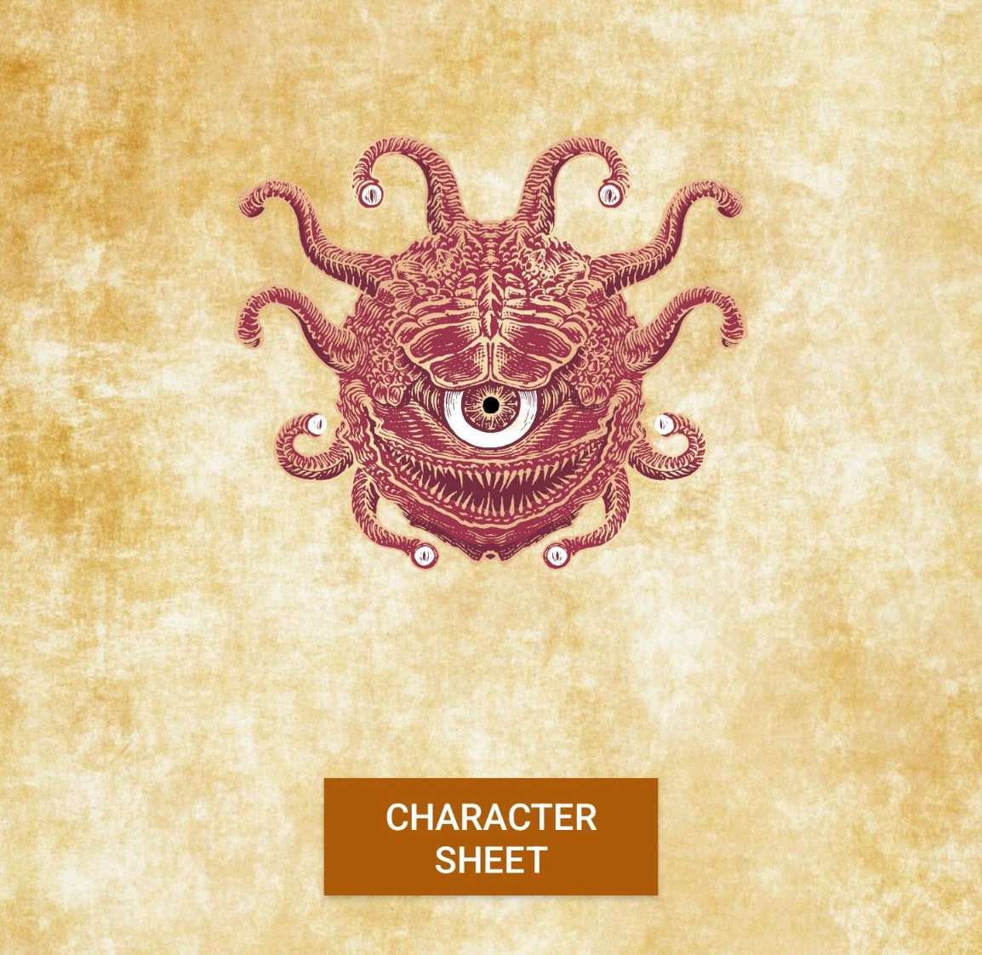
Beholder’s Almanac
Edward Alvarado
CEIS200 Software Engineering May 2022
Android Mobile Application

Slide 2
Project Evaluation
Business Analysis— A small development team could be used to streamline creation of an application like this in the future. Advertising can be handled be done on social media apps. Since the application is a mobile app utilizing the Google Play Store or Apple store would put the sales and support into their infrastructure streamlining the process.
Art (Graphics, Sound)— Background parchment graphics were used on each main page, Beholder creature images were used in a few places. Generic character sheets are used in the character page. Background music is utilized on the main menu.
User Interface— UI is set to be a forced portrait as assets haven’t been created to support landscape. The UI is all touch screen based allowing the user to use both the character creator and dice roller without anything extra.
Design— The design is a basic GUI delivered via smart phone screen with buttons taking the user to different functions. Each function has its own standalone page, and each page allows the user to navigate back to the previous menu.
Code and Programming— The primary programming language used was Java. Most of the development was done on the latest version of Android studio. Some ideas were integrated into the design like the dice random functionality and the ability store user data for later retrieval.
Overall project quality— The main draw of this app over others that exist in market is its vibrant design and easy user experience. Large buttons were used with contrasting text colors to allow users of all ages to engage in the UI. The android API level chosen allows for 98.6% of active devices to have compatibility with the software. Integration with Firebase will allow the user to easily login to the app and securely store data.

Slide 3
Tools Utilized & Recommendations
Since the market discussed is Google Play Store and the platform being worked on is Android Studio the tools most developers would use is Android Studio.
If money was of no concern, we would likely still use Android Studio since its robust IDE helps in the development of Android applications tremendously. Likely we would simply increase team size to speed to development times.
Android Studio is the go-to IDE for this design because of its tool set for both designers and programmers. The built-in emulator allows a designer to plan for multiple types of devices and allows the programmer to design a system that will work on multiple platforms.

Slide 4
Software Engineering Concepts Applied
My biggest software engineering concept that I applied to my project was the proper establishment of software requirements and planning the project around all the laid-out requirements listed. I also utilized the RUP model consistently throughout the project to implement a new function and immediately start testing to ensure functionality.
Having the best practice of properly planning out a design and listing all the requirements necessary for us as software developers to deliver quality in everything we do. A software engineer’s brand is almost as important as the code they deliver. Ensuring that quality is at the forefront of our minds maintains our ability to deliver on that brand we’ve created.

Slide 5
Risk Matrix Beholder’s Almanac
Risks | Likelihood | Preventive Measure | Response | Impact
Hardware Failure | 2 | Test on multiple platforms to ensure wide functionality. | Utilize bug report within settings | Schedule Budget
Cost Risk | 3 | Establish budget based off initial requirement scope Update budget routinely throughout development | Find other resources of money to help support your project | Budget
Appropriate API | 2 | API 28 has been chosen for wide coverage 98.6% and functionality. Always look for cost, support, and reviews | Unsure marketing targets devices with at least API 28. | Requirements Schedule Budget
Time Constraints | 5 | Make a schedule that allows for periodic meetings to update advancement | Alternating paperwork and technical work each week Set weekly goal to motivate and challenge us | Schedule
Technology Risks | 3 | Test on multiple platforms to ensure wide functionality. | List API requirements on Play store | Launch
Marketing Risks | 3 | Use surveys, questionnaires, and reviews to get customers opinion of product | Rework product by changing requirements | Requirements

Slide 6
OOAD Diagram

